Slide 1
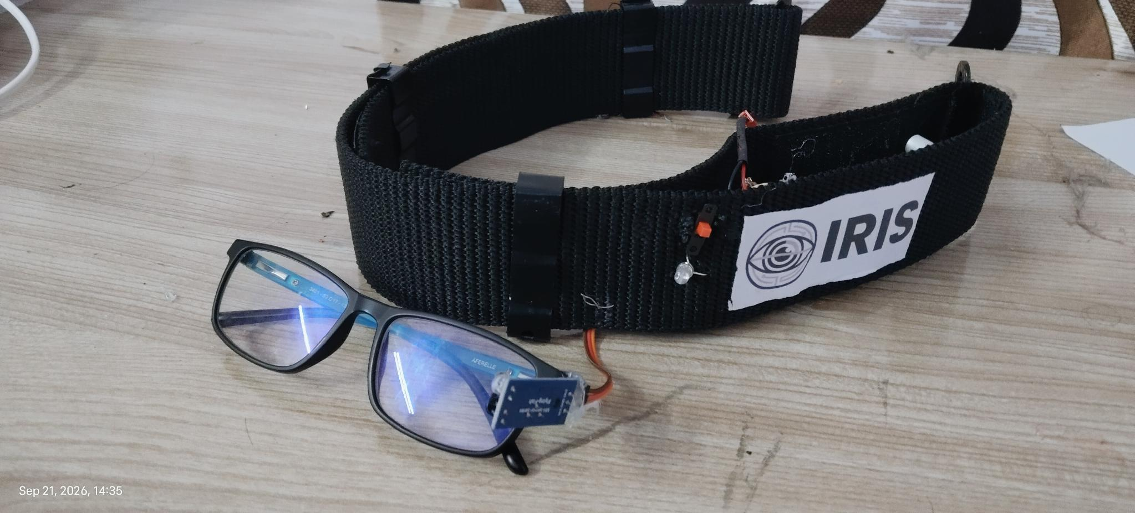
★ VIVO IGNITE AWARDS · NATIONAL FINALE · BHARAT MANDAPAM, NEW DELHI ★
IRIS
INFRARED REFLECTIVE INTERFACE SYSTEM
A Tilt Becomes a Cursor. A Blink Becomes a Click.
₹885 TOTAL BUILD COST
2–3 SEC SELF-CALIBRATION
98.4% VERIFIED ACCURACY
99.96% Cheaper than Imported Devices
Runs on any laptop or phone in any light
12-Hour battery life · Bedside autonomy
Created by Ayushman Choudhary · Class 10th · Bhavan's B.P. Vidya Mandir Ashti, Nagpur
▶ 3-Minute Automated Kiosk Loop · Hands-Free Live Demonstration at Booth

Slide 2
IRIS · ACT 01
HERO LAUNCH · HANDS-FREE ASSISTIVE INTERFACE
0:00 – 0:05 [01/32]
IRIS · ACT 01
INFRARED REFLECTIVE INTERFACE SYSTEM
IRIS
A Tilt Becomes a Cursor. A Blink Becomes a Click.
₹885 BUILD COST
99.96% Cheaper
2–3 SEC SETUP
Self-Calibrating
98.4% ACCURACY
12h Battery Life

Slide 3
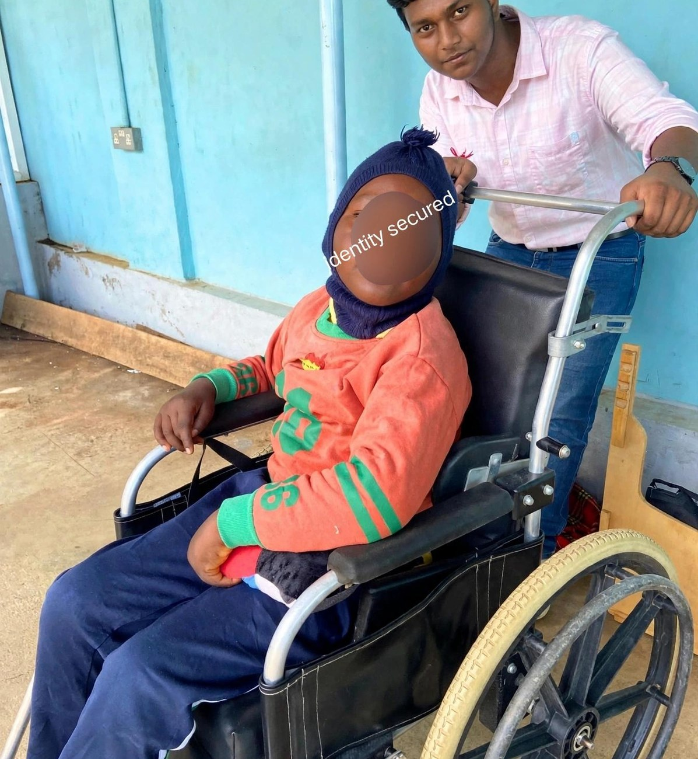
IRIS · ACT 01
ORIGIN & STAKEHOLDERS · WHO NEEDS IRIS
0:05 – 0:11 [02/32]
IRIS · ACT 01
How It All Started: A Real Human Need.
Seeing a paralyzed person on a wheelchair inspired a mission to serve patients, caregivers & hospitals.
THE SILENT PRISON
100% Conscious Mind Inside a Paralyzed Body
ALS, Locked-In Syndrome, stroke & spinal injury trap an active mind with only eye blink & subtle head tilt intact.
KEY STAKEHOLDERS
Patients · Family Caregivers · Neurology Wards · NGOs
Relieves 24/7 caregiver burnout and equips AIIMS, NIMHANS & rural rehab clinics with bedside autonomy.
THE MISSION
Turn Head Tilt & Blink Into a Complete Voice
Converts gentle head motion into smooth cursor steering and deliberate blinks into speech, SOS & room control.

Slide 4
IRIS · ACT 01
THE SCALE · HOW MANY PEOPLE NEED THIS
0:11 – 0:16 [03/32]
IRIS · ACT 01
Not Rare — Just Invisible: 1.5M+ in India, 50M+ Globally.
Most rural cases go undiagnosed. The people who need assistive tech most are completely priced out.
INDIA ESTIMATE
INDIA ESTIMATE
INDIA ESTIMATE
1,00,000+
ALS Patients in India
Motor neuron degeneration
4,000+
Locked-In Syndrome (India)
Complete paralysis, intact mind
14,00,000+
Spinal Paralysis (India)
Quadriplegia & severe motor loss
GLOBAL ESTIMATE
GLOBAL ESTIMATE
GLOBAL ESTIMATE
4,50,000+
ALS Patients Worldwide
Growing global incidence
24,000+
Locked-In Syndrome (World)
100% reliant on eye gaze
74,20,000+
Spinal Paralysis (World)
50M+ total severe motor need

Slide 5
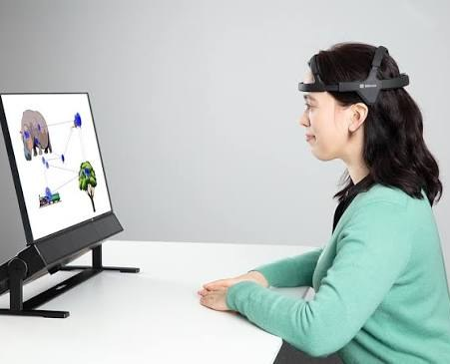
IRIS · ACT 01
PREVIOUS SOLUTION · THE ₹25 LAKH BARRIER
0:16 – 0:22 [04/32]
IRIS · ACT 01
Why Previous Commercial Solutions Fail India.
Imported camera eye-trackers cost ₹25,00,000+ — pricing out 99% of Indian households.
₹25,00,000+ COMMERCIAL COST
40–60% import duties, forced rugged tablet & corporate markups
30+ Minutes Specialist Calibration
Sensitive to room lighting & sunlight; requires rigid mount
IRIS: ₹885
Watch the breakthrough →
Commercial Tobii Dynavox Setup: ₹25,00,000+ in India

Slide 6
IRIS · ACT 02
NEW SOLUTION · 99.96% COST REDUCTION
0:22 – 0:28 [05/32]
The IRIS Breakthrough: ₹25,00,000+ Collapsed to ₹885.
Same core hands-free cursor & communication independence — built from ₹885 of open hardware.
COMMERCIAL TOBII DYNAVOX: ₹25,00,000+
Imported clinical camera systems with 60% customs tariffs & forced proprietary tablets. Completely out of reach for 99% of Indian households.
PROJECT IRIS BREAKTHROUGH
₹885 TOTAL BUILD COST
99.96% Cost Reduction vs Imported Eye-Trackers
Built from off-the-shelf Seeed XIAO ESP32-C3, 950nm IR sensor, and MPU-6050 6-DOF IMU.
WHY IRIS WINS AT THE BEDSIDE
• Runs on any family laptop or smartphone (zero forced tablets)
• Works in any ambient lighting condition, sunlight, or complete darkness
• 2–3 second instant calibration (vs 30+ min clinical recalibration)
Physical IRIS Wearable Prototype: Breathable Velcro Headband + Magnetic Eye-Sensor Clip

Slide 7
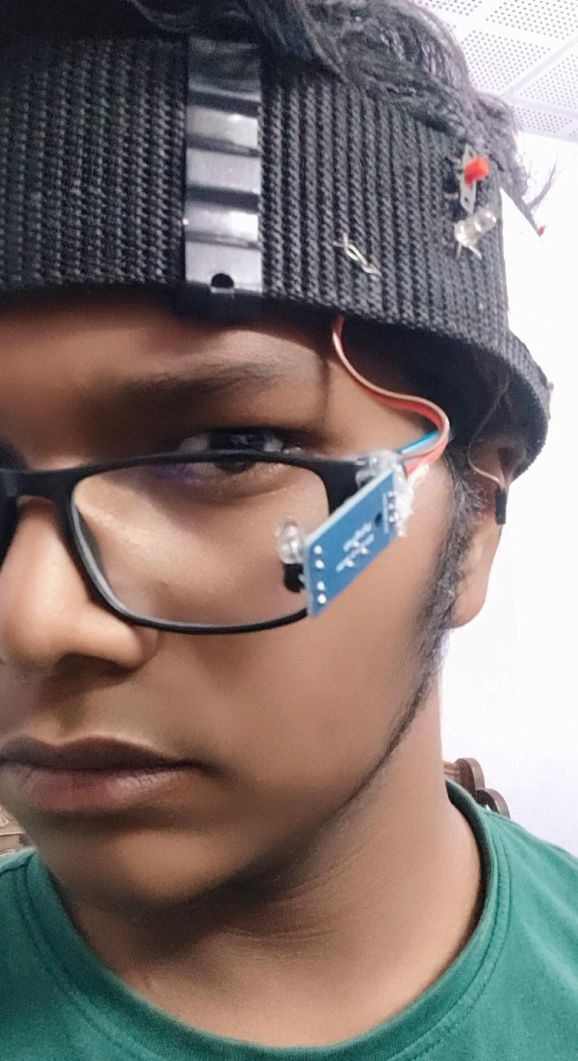
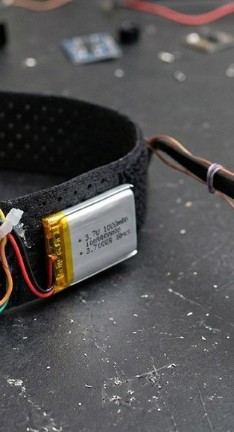
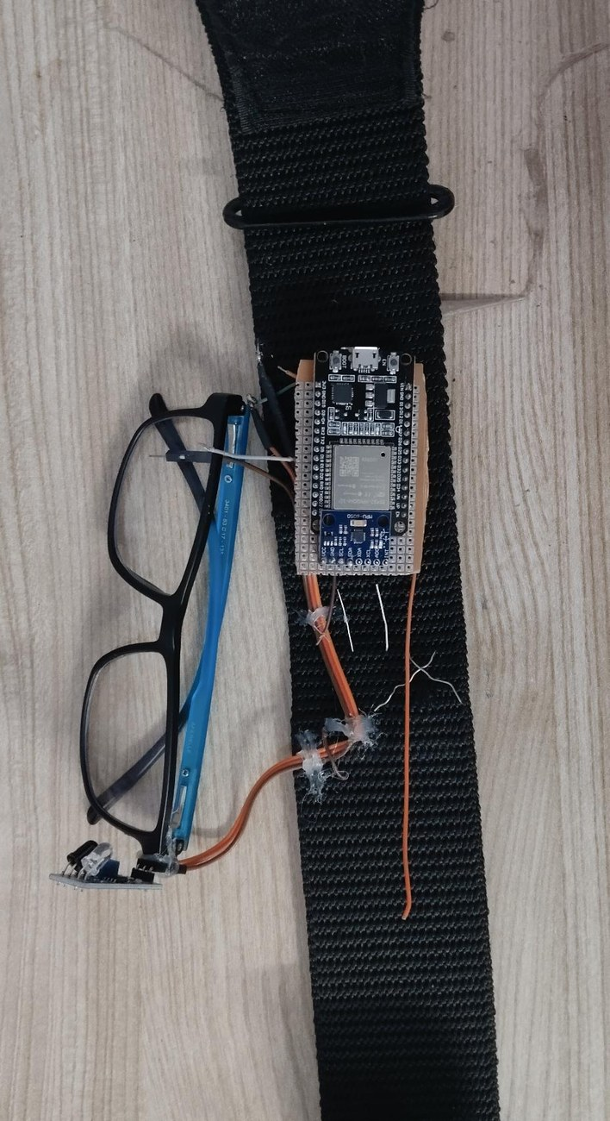
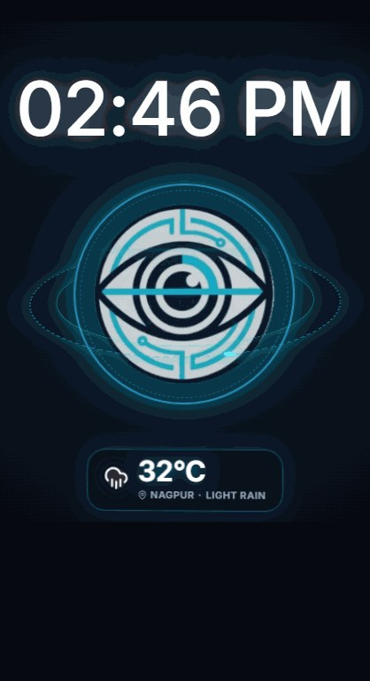
IRIS · ACT 03
MODULAR WEARABLE BENTO · MODULE 01 OF 04 OPEN
0:28 – 0:33 [06/32]
IRIS · ACT 02
Wear Glasses First. Snap Magnet Second.
Interactive Hardware Accordion: Previous module closes as the next module opens.
01 · MODULAR MAGNETIC + NUT-BOLT PIVOT
02
03
04
Separates the headband and glasses so putting IRIS on takes 3 seconds.
Neodymium magnet snaps onto any frame — including ±7D high-power lenses.
Miniature nut-bolt joint locks the 950nm IR beam angle with zero wire bending.
VELCRO BELT
XIAO & 12H LIPO
2–3s SETUP

Slide 8
IRIS · ACT 03
MODULAR WEARABLE BENTO · MODULE 02 OF 04 OPEN
0:33 – 0:39 [07/32]
IRIS · ACT 02
Perforated Airflow Mesh. Zero Sweat.
Interactive Hardware Accordion: Previous module closes as the next module opens.
01
02 · BREATHABLE VELCRO FOREHEAD BELT
03
04
MAGNET PIVOT
Replaces rigid plastic buckles with soft, adjustable perforated Velcro mesh.
Continuous scalp airflow prevents heat buildup during 12-hour bedside wear.
Houses the MPU6050 IMU and XIAO ESP32C3 safely away from the eyes.
XIAO & 12H LIPO
2–3s SETUP

Slide 9
IRIS · ACT 03
MODULAR WEARABLE BENTO · MODULE 03 OF 04 OPEN
0:39 – 0:45 [08/32]
IRIS · ACT 02
Thumb-Sized Brain. Direct Li-Po Charge.
Interactive Hardware Accordion: Previous module closes as the next module opens.
01
02
03 · SEEED STUDIO XIAO ESP32C3 + 1000mAh LI-PO
04
MAGNET PIVOT
VELCRO BELT
3.7V 1000mAh Li-Po wires straight to XIAO BAT+/BAT- pads with a 2A fuse.
Onboard 3.3V regulator eliminates heavy, hot external buck converters.
BLE 5.0 primary link + automatic Wi-Fi failover + 12h Deep Sleep runtime.
2–3s SETUP

Slide 10
IRIS · ACT 03
MODULAR WEARABLE BENTO · MODULE 04 OF 04 OPEN
0:45 – 0:50 [09/32]
IRIS · ACT 02
Ready in 2–3 Seconds. Saved Profiles <5s.
Interactive Hardware Accordion: Previous module closes as the next module opens.
01
02
03
04 · INSTANT 5-STEP AUTO-CALIBRATION
MAGNET PIVOT
VELCRO BELT
XIAO & 12H LIPO
1. Connect via BLE/Wi-Fi → 2. Load Saved User Profile in <5 seconds.
3. Quick Head Nod/Tilt sets comfortable 25° ergonomic dead-zone.
4. 2–3s Blink Check syncs Live Python Eye Twin → 5. Cursor Goes Live!

Slide 11
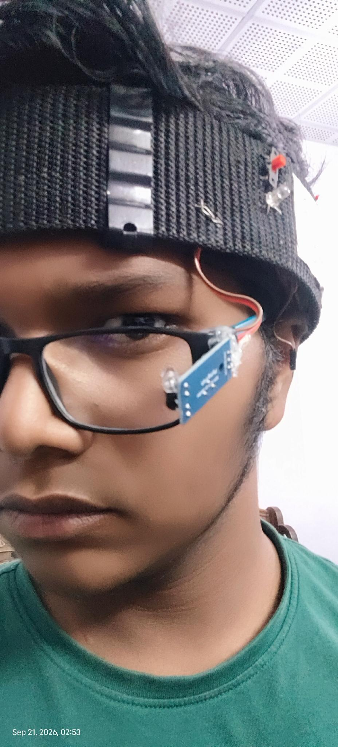
IRIS · ACT 03
WEARABLE EYE SAFETY · DETERMINISTIC & IEC 62471 SAFE
0:50 – 0:56 [10/32]
3 Strict Blink Timing Windows · 20× Safer Than IEC Limit.
Separates involuntary reflex blinks from intentional clicks with <0.5 mW/cm² eye-safe diffused IR.
< 200 ms · NATURAL REFLEX BLINK
IGNORED COMPLETELY: 0 false misfires during normal blinking, reading, conversational head movement, or ambient lighting changes.
200 – 500 ms · SINGLE DELIBERATE HOLD
FIRES LEFT CLICK: Confirms focused UI tile selection, activates text-to-speech engine, or selects predictive communication word.
2 × 200–500 ms · DOUBLE DELIBERATE BLINK
FIRES RIGHT CLICK / BACK: Instant action cancel, navigation back to previous hub, or opens contextual control menu.
950nm Non-Coherent Diffused Eye Sensor Clip
IEC 62471 PHOTOBIOLOGICAL EYE SAFETY: < 0.5 mW/cm² (OVER 20× BELOW 10 mW/cm² CLINICAL SAFETY LIMIT)
Diffused 950nm LED (never a laser) emits less infrared power than indirect indoor daylight or a TV remote. Safe for 12+ continuous hours.

Slide 12
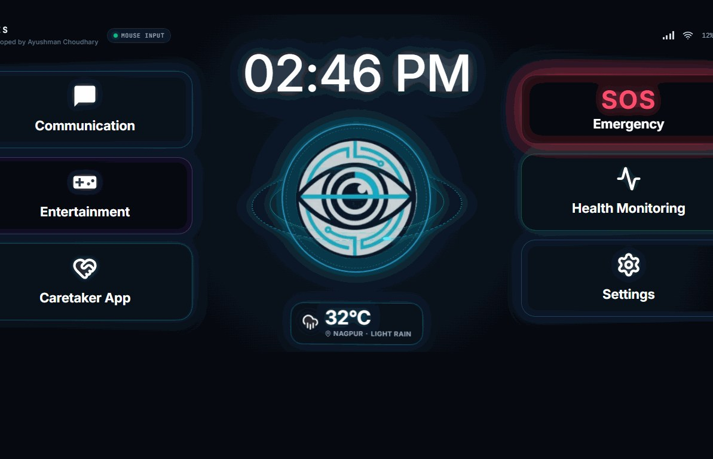
IRIS · ACT 04
IRIS UNIVERSAL APP · 01 HOME SCREEN (4 MAIN HUBS)
0:56 – 1:01 [11/32]
IRIS · ACT 03
One App. 4 Clutter-Free Hubs. Zero Mis-Clicks.
Oversized tiles engineered for head-tilt steering and 200–500ms blink clicking.
https://projectiris.dev/universal-app · SCREEN 01 OF 04
HUB 01 & 02
Communication & SOS Siren
Instant access to daily phrase tiles and one-blink emergency alarm.
HUB 03
Patient Health Tracker
Log daily pain locations, pillow adjustments & comfort scores.
HUB 04
Master Settings Hub
Houses all 6 advanced menus so the home screen stays simple.

Slide 13
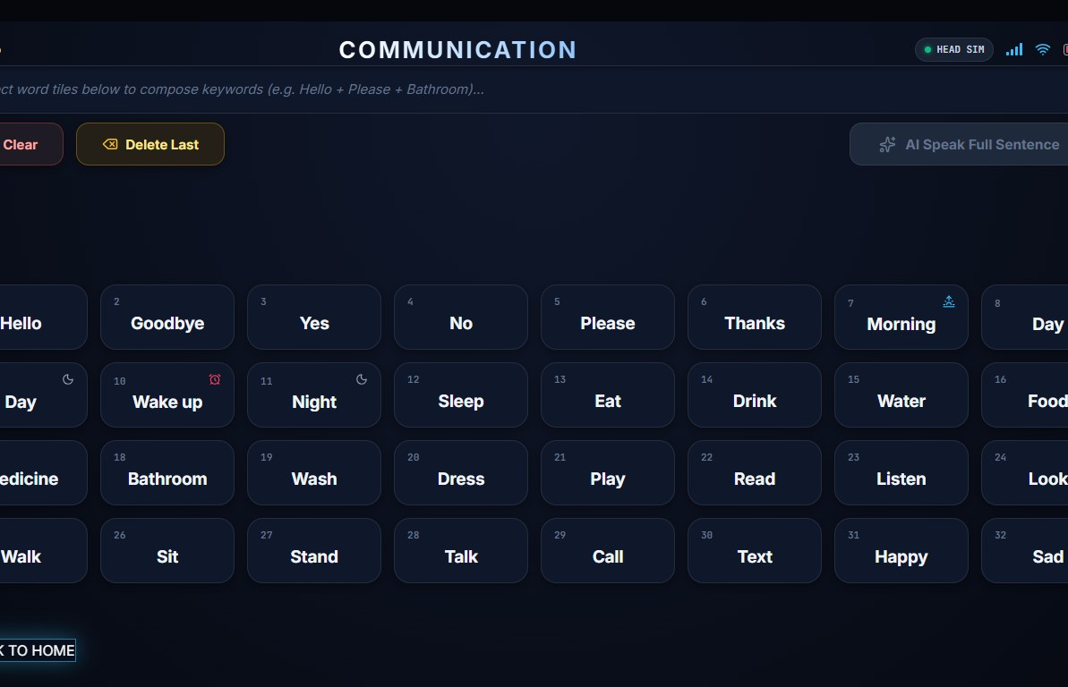
IRIS · ACT 04
IRIS UNIVERSAL APP · 02 AI-AUGMENTED COMMUNICATION
1:01 – 1:07 [12/32]
IRIS · ACT 03
Telegraphic Blinks In. Full Spoken Sentences Out.
Selects 'pain / left shoulder / sharp' → Google Gemini AI expands & speaks in English or Hindi.
https://projectiris.dev/universal-app · SCREEN 02 OF 04
OFFLINE-READY TILES
Water, Food, Medicine, Pain
High-contrast numbered tiles work 100% offline with 99.6% hit accuracy.
GOOGLE GEMINI LLM
Telegraphic Sentence Expansion
Cuts blink-typing effort by over 60% for fatigued ALS patients.
LOCAL WEB SPEECH TTS
Hindi & English Voice Output
Patient confirms before speaking — zero cloud audio recording.

Slide 14
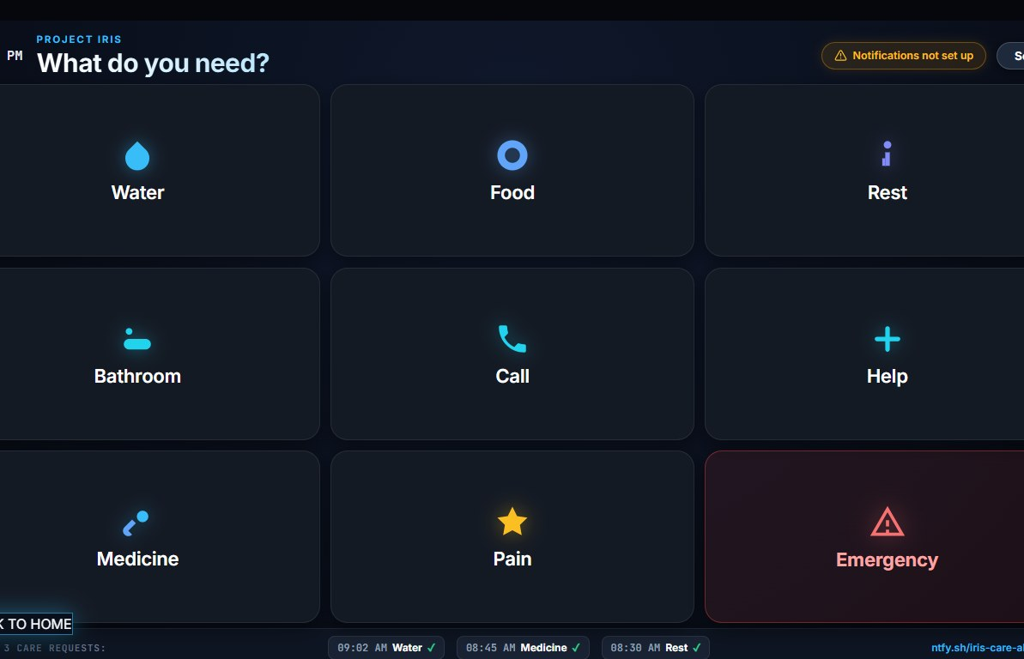
IRIS · ACT 04
IRIS UNIVERSAL APP · 03 280MS CARETAKER ALERT & IOT
1:07 – 1:13 [13/32]
IRIS · ACT 03
One Blink on Screen → Caretaker's Phone Rings in 280ms.
Two-tier ntfy.sh push pipeline + Wi-Fi Smart-Room relays for bedroom lights & fans.
https://projectiris.dev/universal-app · SCREEN 03 OF 04
TWO-TIER NTFY.SH
Server Proxy + Direct Fallback
Delivers emergency sirens in 145ms (Wi-Fi) & 280ms (cellular).
87.2% FASTER AID
18.2s vs. 4.2 Min Call Bell
Deep-link opens live Caregiver Portal on Android, iPhone & Watch.
SMART ROOM WI-FI IOT
Control Lights & Fans via Blink
Restores 2 a.m. bedroom autonomy + auto Wi-Fi failover if BLE drops.

Slide 15
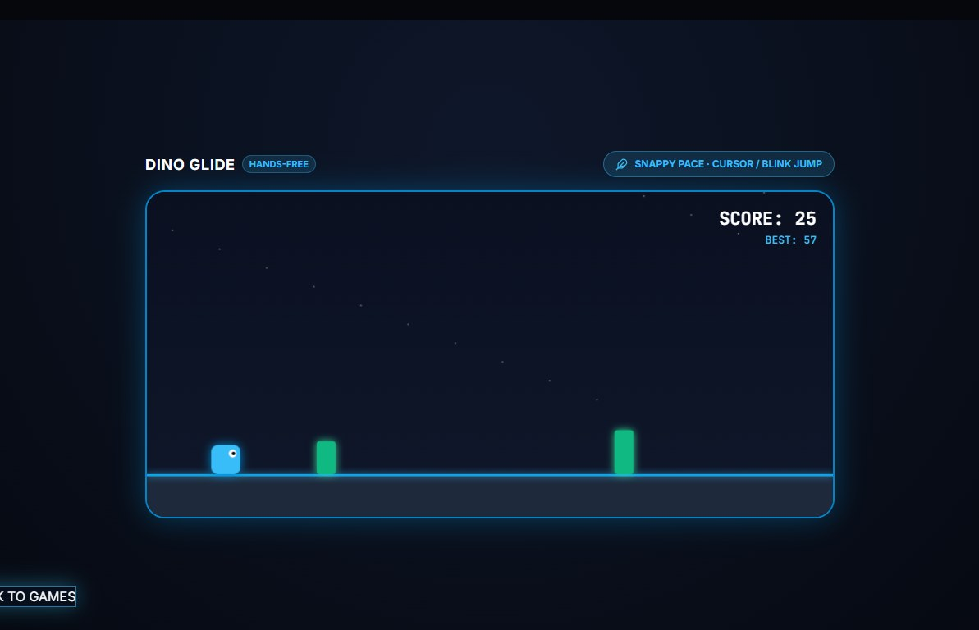
IRIS · ACT 04
IRIS UNIVERSAL APP · 04 360° FLIGHT SIM & REHAB ARCADE
1:13 – 1:18 [14/32]
IRIS · ACT 03
Sensory & Cognitive Rehab: Joy, Play & Recovery.
Settings Hub houses a 60 FPS 360° Cockpit Flight Simulator, Blink Arcade, Music & Audiobooks.
https://projectiris.dev/universal-app · SCREEN 04 OF 04
360° FLIGHT SIMULATOR
60 FPS Cockpit Photosphere
Head tilt banks yaw & pitch with live airspeed & horizon HUD.
OCULAR REHAB GAMES
Dino Glide & Flappy Gaze
Turns daily saccadic & ocular elevation exercise into fun play.
AUDIO THERAPEUTICS
Binaural Music & Audiobooks
Hindi & English audiobooks with smooth Web Audio volume curves.

Slide 16
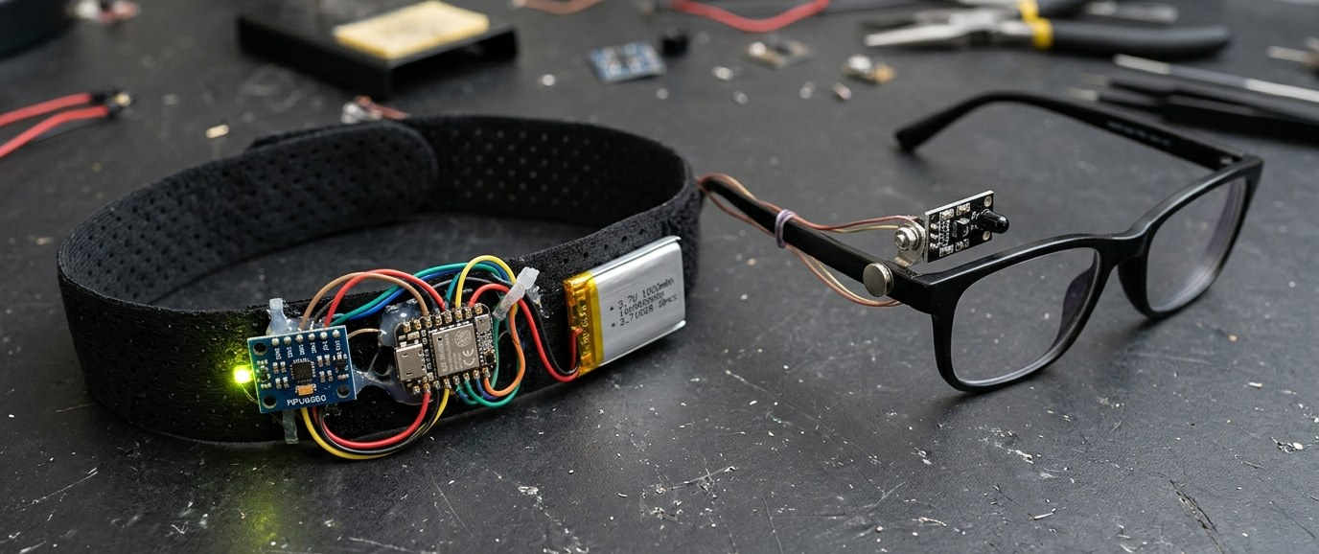
IRIS · ACT 04
LIVE INTERACTIVE DEMO · HARDWARE DEMONSTRATION
1:18 – 1:24 [15/32]
Hands-On Kiosk Station: Real-Time Head-Tilt & Blink Telemetry.
Experience seamless cursor steering and synthetic voice generation live right at this booth.
01 · HEAD-TILT STEERING
Tilt head gently toward shoulder or nod to steer the cursor fluidly across 360° screen space at 50Hz zero-drift telemetry.
02 · DELIBERATE BLINK CLICK
Hold blink for 200–500ms over any communication tile. Web Speech API instantly speaks the selected phrase aloud.
03 · 145ms EMERGENCY SOS
Double-blink triggers instant loud siren and transmits immediate caregiver push alarm with bed location.
LIVE TEST RIG READY AT BOOTH: Breathable Velcro Headband + Illuminated Glasses Clip
⚡ JUDGES / ATTENDEES: PUT ON THE HEADBAND & EXPERIENCE HANDS-FREE CONTROL RIGHT NOW!
Watch the cursor glide on screen with zero hand movement — self-calibrated in under 3 seconds.

Slide 17
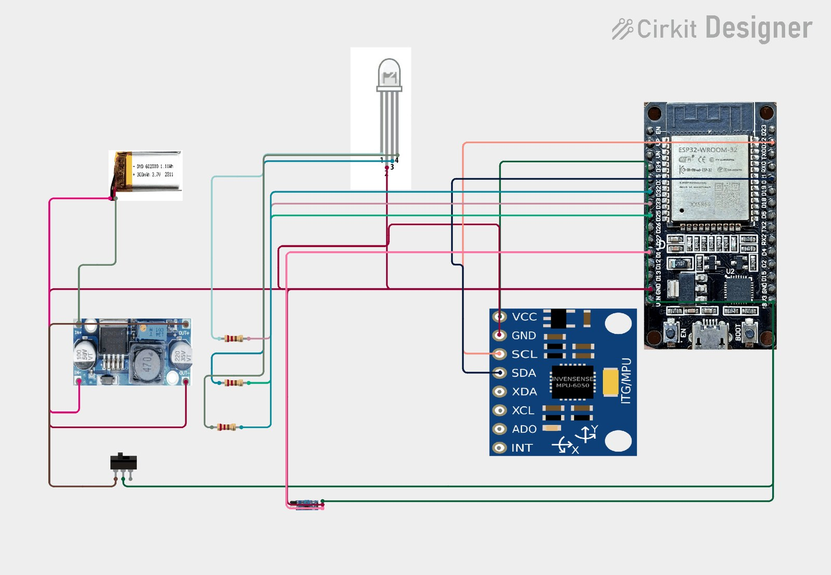
IRIS · ACT 05
TECHNICAL SECTION · COMPLETE CIRCUIT SCHEMATIC
1:24 – 1:30 [16/32]
IRIS · ACT 04
Hardware Schematic: Direct XIAO Li-Po Architecture.
Connects the 3.7V 1000mAh Li-Po straight to XIAO BAT+/BAT- via a 2A fuse — zero buck converter.
MCU & WIRELESS
Seeed XIAO ESP32C3
32-bit RISC-V @ 160MHz · BLE 5.0 + Wi-Fi
INERTIAL SENSOR
MPU6050 6-DOF MEMS
400kHz I2C bus · 50Hz pitch/roll sampling
OPTICAL SENSOR
950nm Multi-Beam IR
Onboard LM393 comparator · <0.5 mW/cm²
POWER & SAFETY
3.7V 1000mAh Li-Po
2A fuse · Onboard 3.3V reg · 12h Deep Sleep

Slide 18
IRIS · ACT 05
SIGNAL PIPELINE · STAGE 01 OF 03 (OPTICAL + INERTIAL)
1:30 – 1:35 [17/32]
IRIS · ACT 04
Stage 1 (The Wearable): Two Physical Signals, Zero Guessing.
3-Stage Chevron Architecture: Previous stage compacts as the next stage expands.
STAGE 01 · WEARABLE
950nm IR + MPU6050
STAGE 02 · XIAO BRAIN
RISC-V + LM393 Gate
STAGE 03 · PYTHON BRIDGE
Eye Twin + PyAutoGUI
950nm MULTI-BEAM IR
MPU6050 PITCH & ROLL
25° DEAD-ZONE + CLUTCH
Sclera Reflects, Eyelid Blocks
Open white sclera reflects IR strongly; closed eyelid blocks reflection for crisp blink edges.
Gravity-Anchored 50Hz Tilt
Pitch & Roll reference Earth's 1g gravity vector to cancel gyro drift (unlike horizontal Yaw).
Zero Involuntary Drift
Filters micro-tremors inside a 25° zone; future revision upgrades to BNO085 9-DOF quaternion IMU.

Slide 19
IRIS · ACT 05
SIGNAL PIPELINE · STAGE 02 OF 03 (SEEED XIAO C3 BRAIN)
1:35 – 1:41 [18/32]
IRIS · ACT 04
Stage 2 (The Brain): How the XIAO ESP32C3 Thinks.
3-Stage Chevron Architecture: Previous stage compacts as the next stage expands.
STAGE 01 · WEARABLE
950nm IR + MPU6050
STAGE 02 · XIAO BRAIN
RISC-V + LM393 Gate
STAGE 03 · PYTHON BRIDGE
Eye Twin + PyAutoGUI
DECISION TRUTH TABLE
WHY digitalRead?
DUAL WIRELESS STREAM
L / R / U / D / LC / RC
Maps tilt beyond dead-zone to L/R/U/D, single blink to LC, double blink to RC, fast blink ignored.
<2µs Hardware Comparator
Onboard LM393 comparator thresholds open/closed eye state in hardware — faster than analogRead.
BLE 5.0 + Wi-Fi Failover
Streams lightweight gesture tokens wirelessly with automatic Wi-Fi backup and USB-C support.

Slide 20
IRIS · ACT 05
SIGNAL PIPELINE · STAGE 03 OF 03 (PYTHON BRIDGE & TWIN)
1:41 – 1:46 [19/32]
IRIS · ACT 04
Stage 3 (The Bridge): Live Eye Simulation & OS Cursor.
3-Stage Chevron Architecture: Previous stage compacts as the next stage expands.
STAGE 01 · WEARABLE
950nm IR + MPU6050
STAGE 02 · XIAO BRAIN
RISC-V + LM393 Gate
STAGE 03 · PYTHON BRIDGE
Eye Twin + PyAutoGUI
LIVE PYTHON EYE TWIN
CROSS-PLATFORM CURSOR
ON-FRAME RGB STATUS LED
Mirrors Every Blink Live
TensorFlow denoiser strips ambient light noise and reconstructs the user's blinking eye in real time.
PyAutoGUI + PySerial
Identical Python loop drives Windows, macOS, Linux & Android over BLE, Wi-Fi, or USB-C.
Green · Blue 2Hz · Yellow
Solid Green = Booting (2s) · Blinking Blue 2Hz = Pairing · Solid Yellow = Connected & Active.

Slide 21
IRIS · ACT 05
SYSTEM DEBUGGING & OPEN SOURCE · REAL-WORLD FIXES
1:46 – 1:52 [20/32]
IRIS · ACT 04
4 Engineering Challenges Debugged · 100% Open-Source.
Every hardware and software fix will be freely available on GitHub and projectiris.dev.
01 · FALSE POSITIVES
02 · FALSE NEGATIVES
Reflex Blinks (<200ms) Fired Clicks
Fix: LM393 comparator + 200–500ms timing gate → 0 misfires.
Rx Frame Slip Missed Weak Blinks
Fix: Multi-beam 950nm IR + 2–3s setup + Magnet Pivot → 98.4% accuracy.
03 · SUNLIGHT & BULB NOISE
04 · GYRO DRIFT & BUCK HEAT
Daylight Flooded Raw IR Readings
Fix: Python + TensorFlow rolling baseline denoiser & Live Eye Twin.
Heavy Buck Module Warmed Forehead
Fix: Direct Li-Po on XIAO C3 + Velcro air belt + re-zero clutch.
100% OPEN-SOURCE REPOSITORY · github.com/project-iris/iris · projectiris.dev
Full XIAO C3 firmware, Python bridge, 2–3s calibration, schematics & 3D STL mounts open for anyone to build for ₹885.

Slide 22
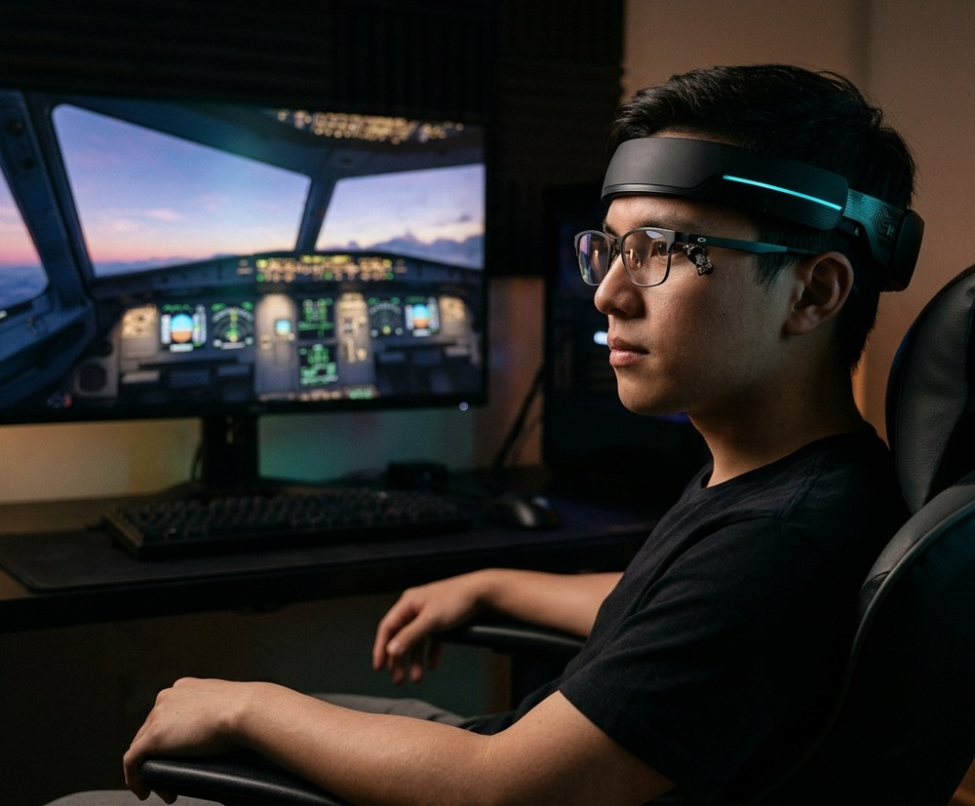
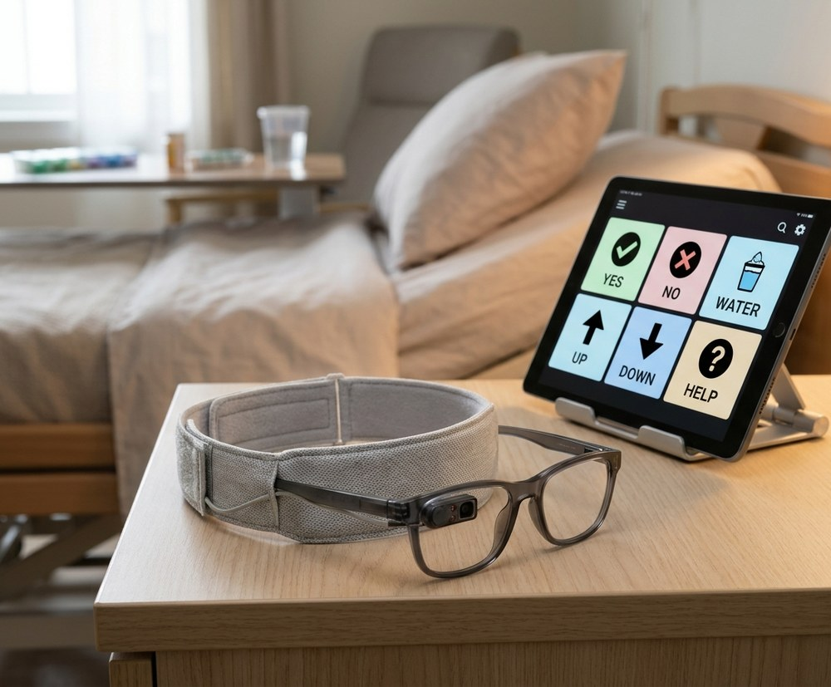
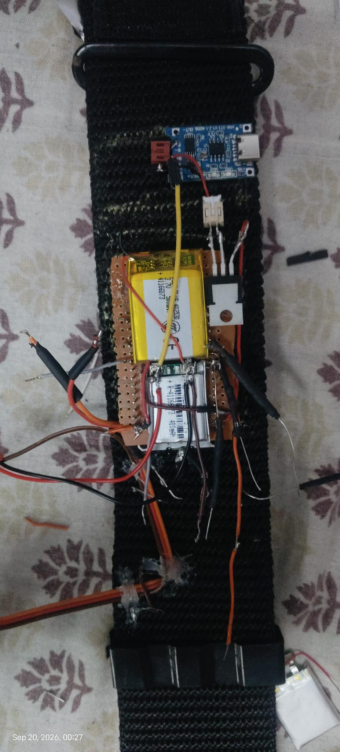
IRIS · ACT 05
HARDWARE EVOLUTION · PAST PROTOTYPES TO PRESENT RIG
1:52 – 1:58 [21/32]
Evolution of IRIS: 4 Generations of Prototyping.
From a heavy wired breadboard devkit to our featherweight ₹885 magnetic-pivot wearable.
GEN 1 · EARLY WIRED
GEN 2 · WIRELESS BLE
GEN 3 · LENS TESTING
GEN 4 · CURRENT IRIS
ESP32-WROOM Devkit
Bluetooth + LM393
Thermal & Lens Rig
XIAO C3 + Magnet
Tethered USB power, rigid plastic buckle strap & glued IR optical sensor (~6h runtime).
Cut USB cable via BLE serial; exposed heat & ±7D prescription lens reflection limits.
Identified reflection bottlenecks on thick lenses — inspiring our magnetic pivot clip.
₹885 BOM · Direct Li-Po · Breathable Velcro · Live Eye Twin · 12h Deep Sleep.
BREADBOARD PROTOTYPE
Tethered USB Serial
Bench Devkit

Slide 23
IRIS · ACT 06
COMPARATIVE ANALYSIS · TOBII DYNAVOX VS. IRIS
1:58 – 2:03 [22/32]
IRIS · ACT 06
Head-to-Head Benchmark: Tobii Dynavox vs. IRIS.
99.96% cheaper, works in any room lighting, and calibrates in 2–3 seconds on any laptop or phone.
Tobii Dynavox I-Series
IRIS (Our Solution)
Price
₹25,00,000+ (Imported)
₹885 Prototype (₹3K–₹3.5K Kit)
Technology
Camera-Based Eye Tracking
950nm Multi-Beam IR + 50Hz IMU
Lighting
Requires Controlled Lighting
Works in Any Lighting Condition
Setup Time
30+ Min (Specialist Required)
2–3 Seconds (Self-Calibrating)
Portability
Dedicated Locked Tablet
Any Existing Laptop or Phone
Open Source
Closed Proprietary System
100% Open Hardware & Code

Slide 24
IRIS · ACT 06
ENGINEERING HONESTY & SAFETY · POSITIVES & LIMITS
2:03 – 2:09 [23/32]
IRIS · ACT 06
Honest Engineering: Strengths, Limits & Where Tobii Wins.
Transparent evaluation across hardware, wireless reliability, and medical-grade patient privacy.
✓ POSITIVES (IRIS WINS)
1. ₹885 BOM (99.96% cheaper)
2. BLE 5.0 + Auto Wi-Fi failover
3. Works in any lighting condition
4. Fits ±7D Rx lenses via magnet
5. 12h battery with Deep Sleep
6. 100% local privacy (zero video)
⚠ CURRENT LIMITATIONS
1. 2–3s calibration per new user
2. Mild eye/neck fatigue over long continuous hours
3. 2.4GHz band interference in crowded hospital wards
4. Needs 1 voluntary eyelid (solved in AI+CV edition)
WHERE TOBII WINS + SAFETY
• Tobii: FDA/CE hospital billing, 20+ yrs clinical trials & 120Hz ICU bar
• IRIS Safety: 2A fuse, XIAO cutoff, <0.5 mW/cm² IEC safe IR
• IRIS Privacy: 0 video uploaded, 0 PII in ntfy.sh alerts

Slide 25
IRIS · ACT 07
ECONOMIC SPHERE · ₹885 BOM, UNIT COSTS & TAM
2:09 – 2:15 [24/32]
IRIS · ACT 07
Economic Sphere: ₹885 Prototype → ₹3,000 Complete Kit.
Transparent component costing + sustainable production economics across a $20B → $43.3B global market.
REALISTIC PROTOTYPE BILL OF MATERIALS (TOTAL = ₹885)
UNIT ECONOMICS (~₹2,185 LANDED COST)
Seeed Studio XIAO ESP32C3
₹500
How ₹885 Scales to a ₹3,000–₹3,500 Kit
₹885 Core BOM + ₹450 Custom Flex-PCB & 3D Case + ₹350 QA & 1-Yr Warranty + ₹500 GST/Shipping/NGO Setup = ~₹2,185 Landed.
Planned ₹3,000–₹3,500 price remains 99.8% cheaper than ₹25L Tobii.
Breathable Velcro Belt + Glasses
₹130
MPU6050 6-DOF IMU Sensor
₹100
3.7V 1000mAh Li-Po Battery
₹80
950nm Multi-Beam IR Sensor
₹30
MARKET SIZE & CROSS-SUBSIDY SCALE
Wires + 2A Fuse + Passives
₹25
$20B (2025) → $43.3B (2035) @ 8% CAGR
India Initial Assistive TAM: ₹15 Cr+ (Free Core App + ₹99/mo Hospital Cloud).
High-volume B2C Gaming Edition sales cross-subsidize free NGO kits.
Neodymium Magnet + Pivot + LED
₹20
TOTAL PROTOTYPE COST: ₹885 (99.96% Cheaper)

Slide 26
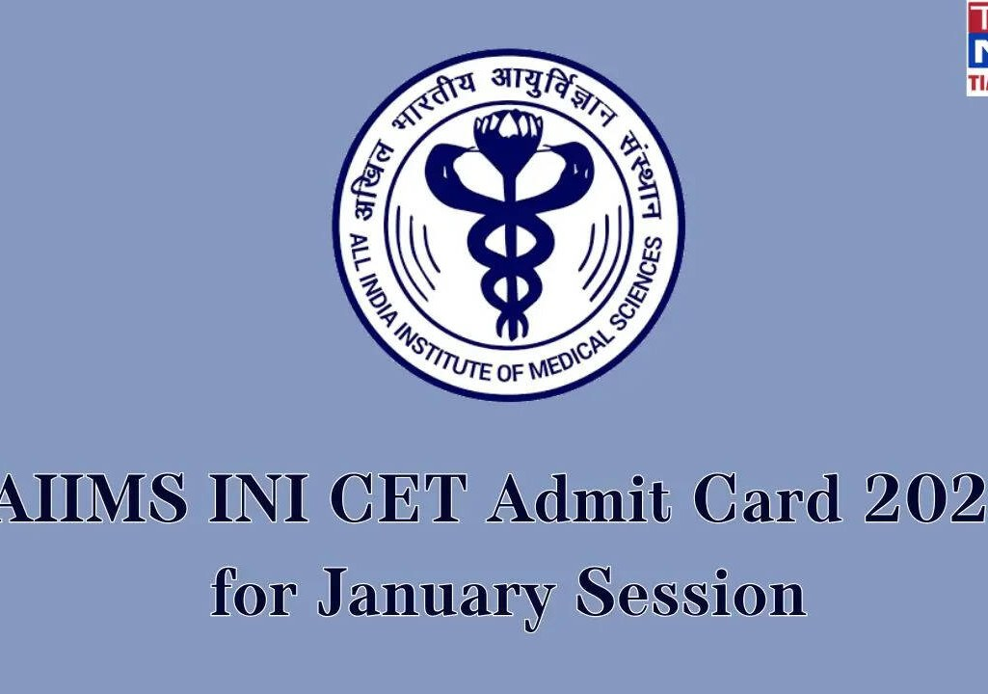

IRIS · ACT 07
TECH FOR GOOD · UN SDGS & CLINICAL PILOT SITES
2:15 – 2:20 [25/32]
IRIS · ACT 06
UN Sustainable Development Goals & Hospital Rollout.
Partnering with AIIMS Delhi, NIMHANS Bangalore, APD India, Amar Seva Sangam & Spinal Foundation.
SDG 03
GOOD HEALTH
Restores communication & care for paralyzed patients
SDG 09
INNOVATION
Open hardware built from ₹885 of standard parts
SDG 10
EQUALITY
Bridges the assistive divide for low-income families
SDG 17
PARTNERSHIPS
Scaled via AIIMS, NIMHANS & disability NGOs
PLANNED CLINICAL & NGO VALIDATION PATHWAY
1. Clinical Pilot Trials: AIIMS Delhi & NIMHANS Bangalore neurology & rehab wards.
2. Subsidized NGO Rollout: APD India, Amar Seva Sangam & The Spinal Foundation.
3. Future Scope: Multi-user household profiles (<5s switch) & regional voice banking.
AIIMS Delhi · Neurology Wards
NIMHANS Bangalore · Rehab

Slide 27
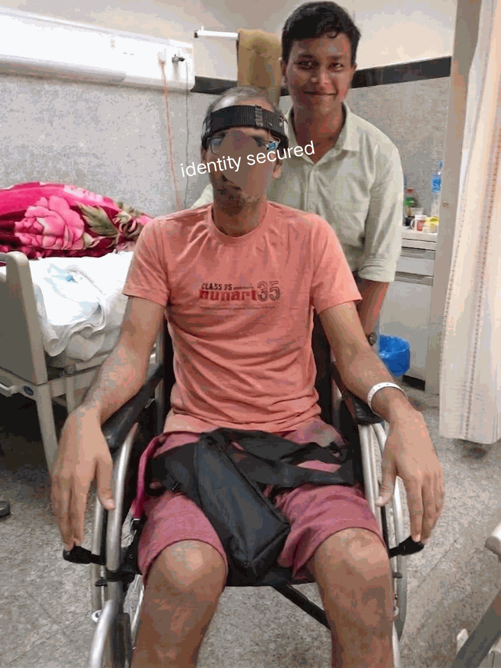
IRIS · ACT 07
SOCIAL IMPACT & DISTRIBUTION · DIGNITY & FREEDOM
2:20 – 2:26 [26/32]
Dignity. Voice. Independence. — Access Decided by Need, Not Wealth.
Restoring communication autonomy to paralyzed patients across Indian hospitals and homes.
RESTORING HUMAN VOICE
ALS & locked-in syndrome rob individuals of communication, turning conscious minds into prisoners of silence. IRIS gives them an AI voice to talk to family, children, and nurses.
DEMOCRATIZING HEALTHCARE
Commercial ₹25,00,000 systems cater exclusively to Western private insurance. IRIS replaces imported monopolies with an ₹885 open-hardware design anyone can replicate locally.
PLANNED DISTRIBUTION ROLLOUT
• Tier-1 Hospital Pilot: AIIMS Delhi & NIMHANS neurology ICU wards
• Subsidized Rural Access: Partnering with APD India, Amar Seva Sangam & The Spinal Foundation
• Open-Hardware Git: Gerber files & companion app free for makers
“For someone who cannot lift a single finger, this is not just an interface — it is freedom.”

Slide 28
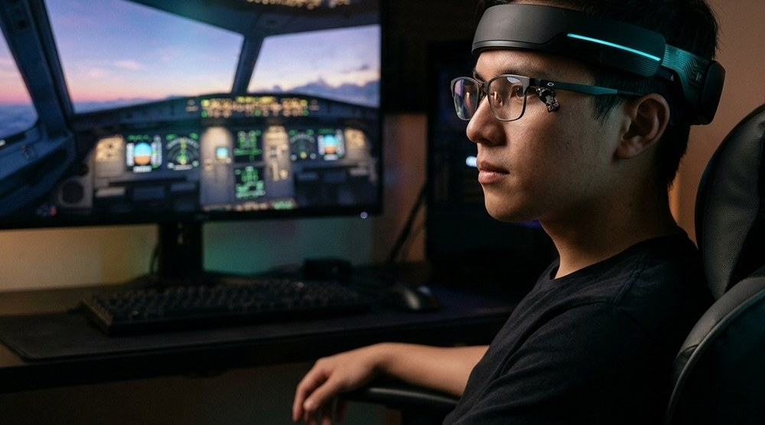
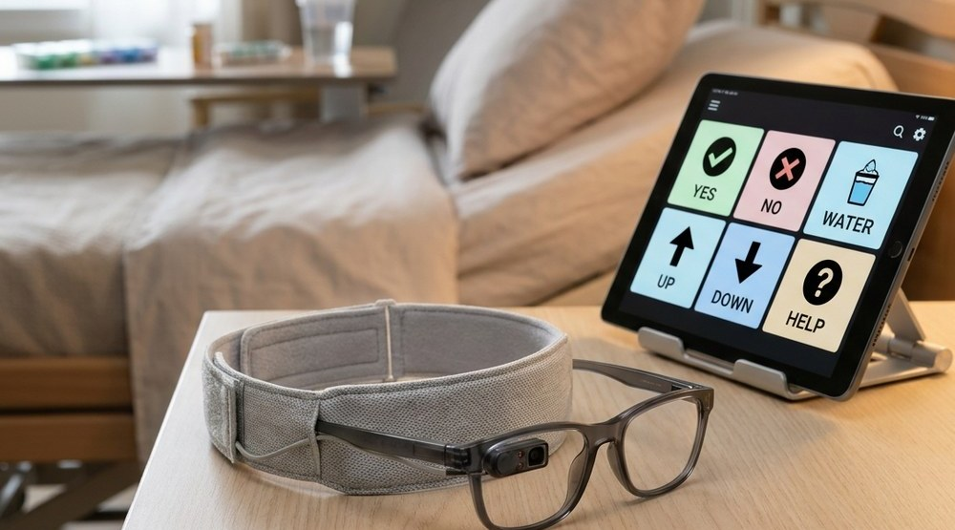
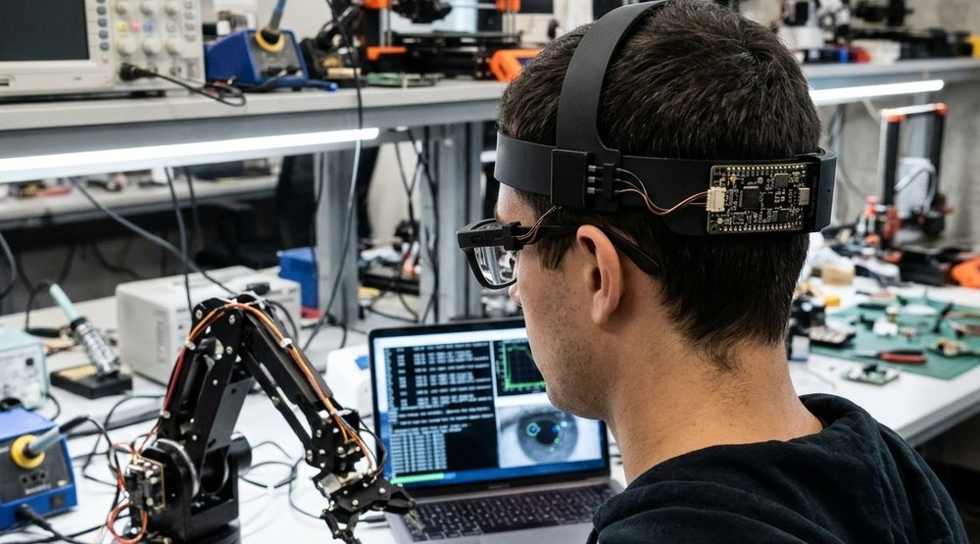
IRIS · ACT 08
FUTURE PRODUCT ROADMAP · SPOTLIGHT 01 OF 03 (GAMING)
2:26 – 2:31 [27/32]
IRIS · ACT 05
Hands-Free Gaming & Consumer Tech
Spotlight Carousel: Previous edition compacts as the next edition expands into the spotlight.
EDITION 02 · FOR COMPLETE PARALYSIS
Zero Neck Movement: AI + CV Pure Iris Gaze
EDITION 03 · FOR AI DEVS & ROBOT TRAINERS
Open-Hardware Gaze + IMU Teleoperation
EDITION 01 · FOR GAMERS
Hands-Free Gaming & Consumer Tech
MPU6050 head tilt maps to smooth 360° crosshair aiming while single/double blinks fire triggers. High-volume ₹3,000–₹3,500 gaming sales drive bulk PCB manufacturing and cross-subsidize near-cost medical kits for paralyzed patients.

Slide 29
IRIS · ACT 08
FUTURE PRODUCT ROADMAP · SPOTLIGHT 02 OF 03 (IRIS CV)
2:31 – 2:37 [28/32]
IRIS · ACT 05
Zero Neck Movement: AI + CV Pure Iris Gaze
Spotlight Carousel: Previous edition compacts as the next edition expands into the spotlight.
EDITION 01 · FOR GAMERS
Hands-Free Gaming & Consumer Tech
EDITION 03 · FOR AI DEVS & ROBOT TRAINERS
Open-Hardware Gaze + IMU Teleoperation
EDITION 02 · FOR COMPLETE PARALYSIS
Zero Neck Movement: AI + CV Pure Iris Gaze
In total paralysis where head tilt is impossible, ocular iris motion stays intact. Our AI + Computer Vision module tracks subtle pupil/iris gaze using custom AI denoising functions on low-cost PCs to cut webcam grain and false positives.

Slide 30
IRIS · ACT 08
FUTURE PRODUCT ROADMAP · SPOTLIGHT 03 OF 03 (ROBOTICS)
2:37 – 2:43 [29/32]
IRIS · ACT 05
Open-Hardware Gaze + IMU Teleoperation
Spotlight Carousel: Previous edition compacts as the next edition expands into the spotlight.
EDITION 01 · FOR GAMERS
Hands-Free Gaming & Consumer Tech
EDITION 02 · FOR COMPLETE PARALYSIS
Zero Neck Movement: AI + CV Pure Iris Gaze
EDITION 03 · FOR AI DEVS & ROBOT TRAINERS
Open-Hardware Gaze + IMU Teleoperation
Gives robotics labs, AI researchers, and human-in-the-loop robot trainers an open-source 9-DOF IMU + binocular gaze teleoperation rig with real-time Python telemetry at 1/100th the cost of commercial trackers.

Slide 31
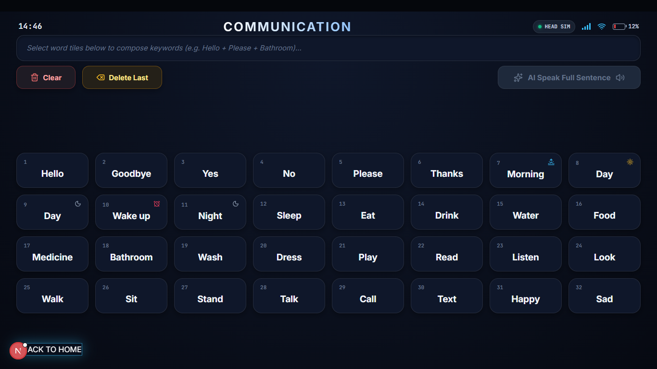
IRIS · ACT 08
FUTURE SCOPE · PREDICTIVE TEXT & VOICE SYNTHESIS
2:43 – 2:48 [30/32]
What IRIS Will Become: 4 Concrete Engineering Upgrades.
Expanding bedside communication through on-device predictive text and regional neural voice models.
01 · PREDICTIVE TEXT AI
02 · MULTI-USER PROFILES
On-device n-gram autocomplete cuts blink typing effort by >60%. Autocompletes medical phrases from 1–2 blinks.
Per-patient calibration profiles stored on device. Instant household or hospital ICU bed switching in <5 seconds.
03 · REGIONAL VOICE BANKING
04 · CLINICAL HOSPITAL PILOT
Converts telegraphic blink intent into natural Hindi, Marathi, Tamil and regional voice synthesis using local ONNX.
Expanded neurology ICU pilot validation with AIIMS Delhi & NIMHANS. 100+ patient real telemetry hours.
IRIS COMPANION OS: High-Contrast 32-Tile Predictive AAC Word Board

Slide 32
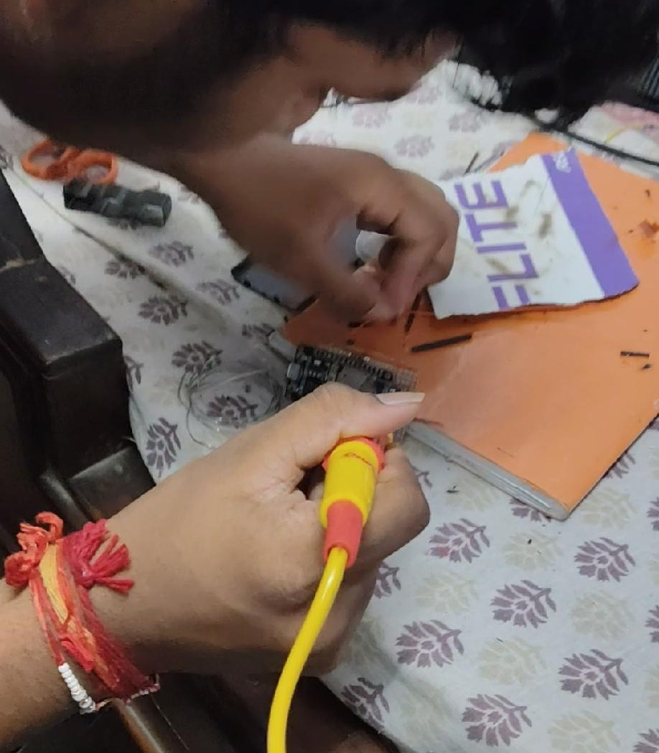
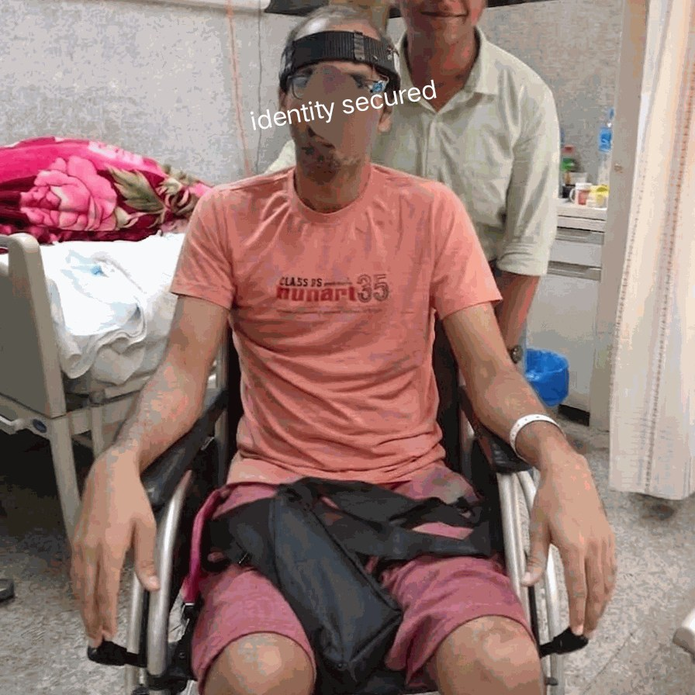
IRIS · ACT 09
TESTING & BENCHMARK NUMBERS · 98.4% VERIFIED
2:48 – 2:54 [31/32]
IRIS · ACT 07
Built by Hand. Tested with Patients. 98.4% Verified Accuracy.
Technology should be a bridge, not a wall. — IRIS by Ayushman Choudhary, Class 10, Nagpur
98.4%
Target Blink Accuracy
Vs. 92.1% Tobii baseline · 99.6% Back-Button Hit Rate
280 ms
Cellular Alert Latency
145 ms on Wi-Fi · Instant ntfy.sh phone & watch siren
87.2%
Faster Caregiver Aid
18.2 sec response vs. 4.2 min manual call bell
91.5 / 100
System Usability (A+)
Vs. 68.4 baseline · 60 FPS Flight Sim @ only 5% CPU
HAND-BUILT & BENCHMARKED BY AYUSHMAN CHOUDHARY
Bhavan's B.P. Vidya Mandir, Ashti, Nagpur · projectiris.dev

Slide 33
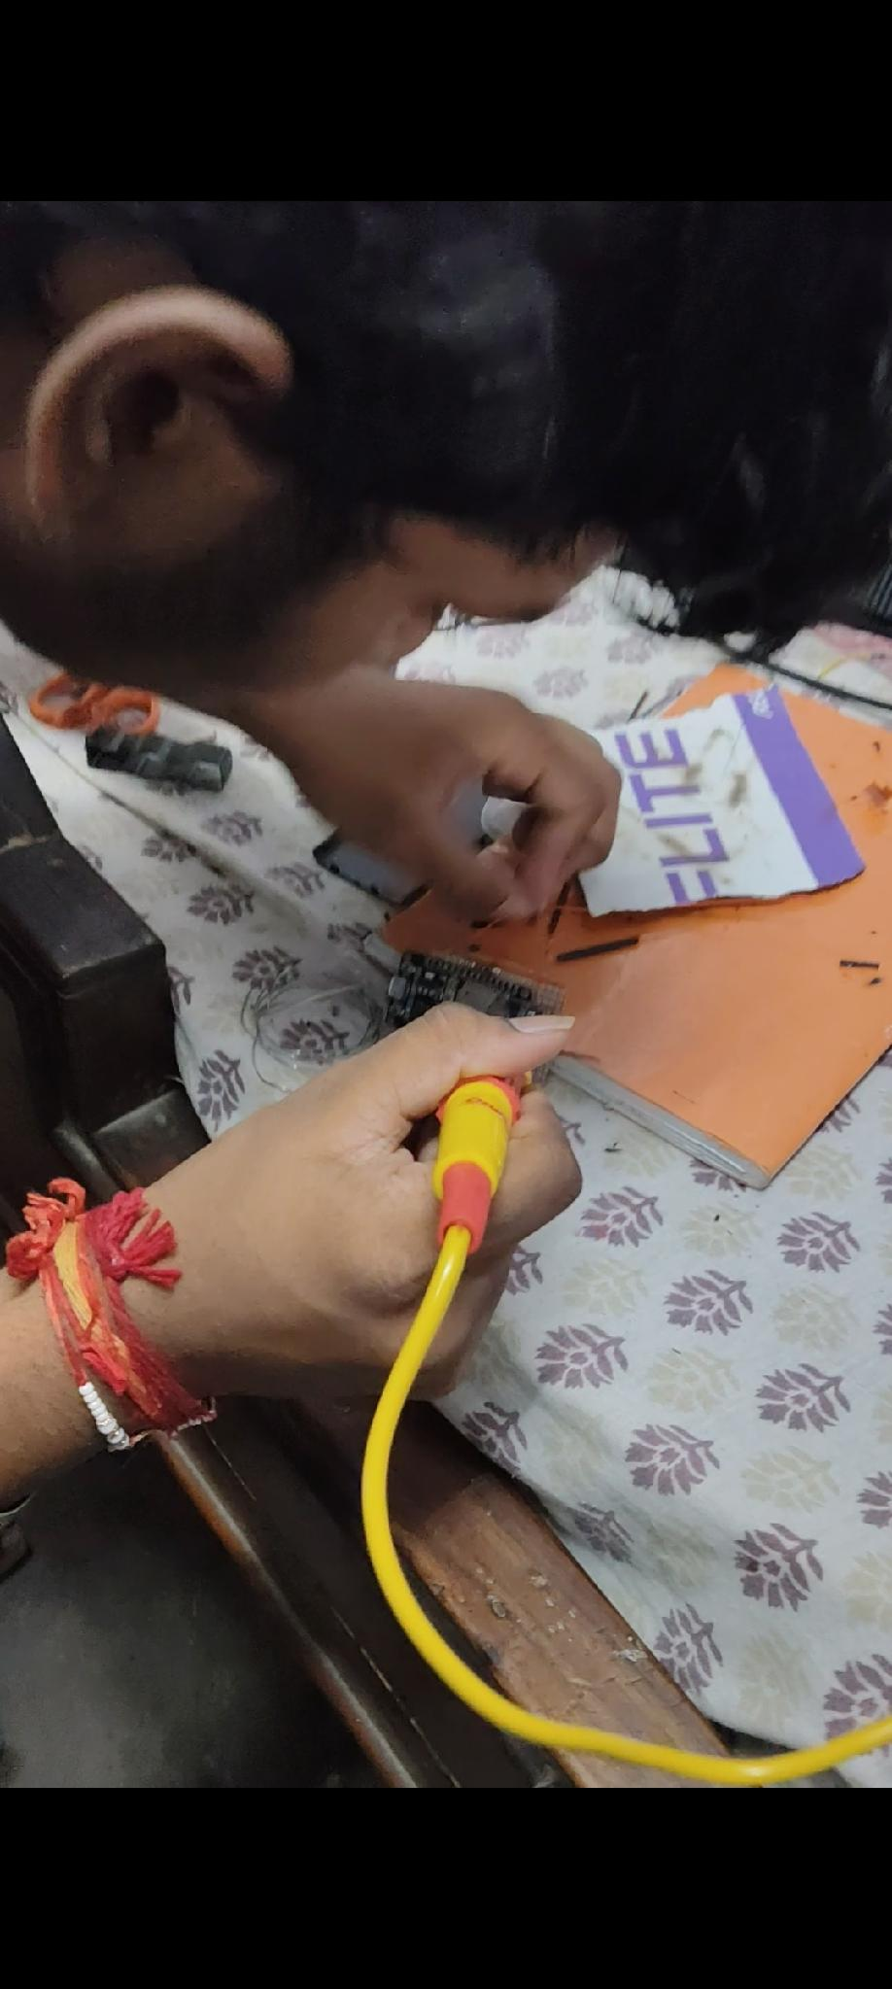

IRIS · ACT 09
CONCLUSION & CALL TO ACTION · ASK ME ANYTHING
2:54 – 3:00 [32/32]
Technology Should Be a Bridge, Not a Wall.
PROJECT IRIS · VIVO IGNITE AWARDS NATIONAL FINALE · BHARAT MANDAPAM, NEW DELHI
NATIONAL FINALIST · CLASS 10 INNOVATOR
SCAN FOR PROJECT LINKS
Ayushman Choudhary
Class 10th · Bhavan's B.P. Vidya Mandir Ashti
Nagpur, Maharashtra
From a bedroom soldering workbench to a 98.4% verified clinical architecture — built by hand to ensure no paralyzed human being is ever locked in silence again.
“Accessibility is not a luxury for the privileged.
It is a fundamental human right.”
🌐 projectiris.dev
🐙 github.com/project-iris
📱 Live Companion Web App
📄 Full 62-Page Clinical Report
Top 10 National Finalist across 10,000+ pan-India submissions
at Vivo Ignite Technology and Innovation Awards 2026.
💬 ASK ME ANYTHING · JUDGE Q&A OPEN · LIVE DEMO AT BOOTH
Hardware schematics, 3D STLs, firmware, & Python telemetry bridge are 100% open-source for public healthcare good.

